Slide 1

INSIGHTS INTO ACCIDENT SEVERITY IN THE U.S.
BY FABIO D’ERRICO

Slide 2

agenda
U.S. States with the Highest Average Accident Severity Score
Precipitation and Accident Severity Relation
Monthly Severity Trends
Impact of Traffic Signals on Accident Severity
Visibility and Accident Severity Analysis
Temperature Impact on Accident Severity
Weather Conditions and Accident Severity
Accident Severity by Amenity

Slide 3
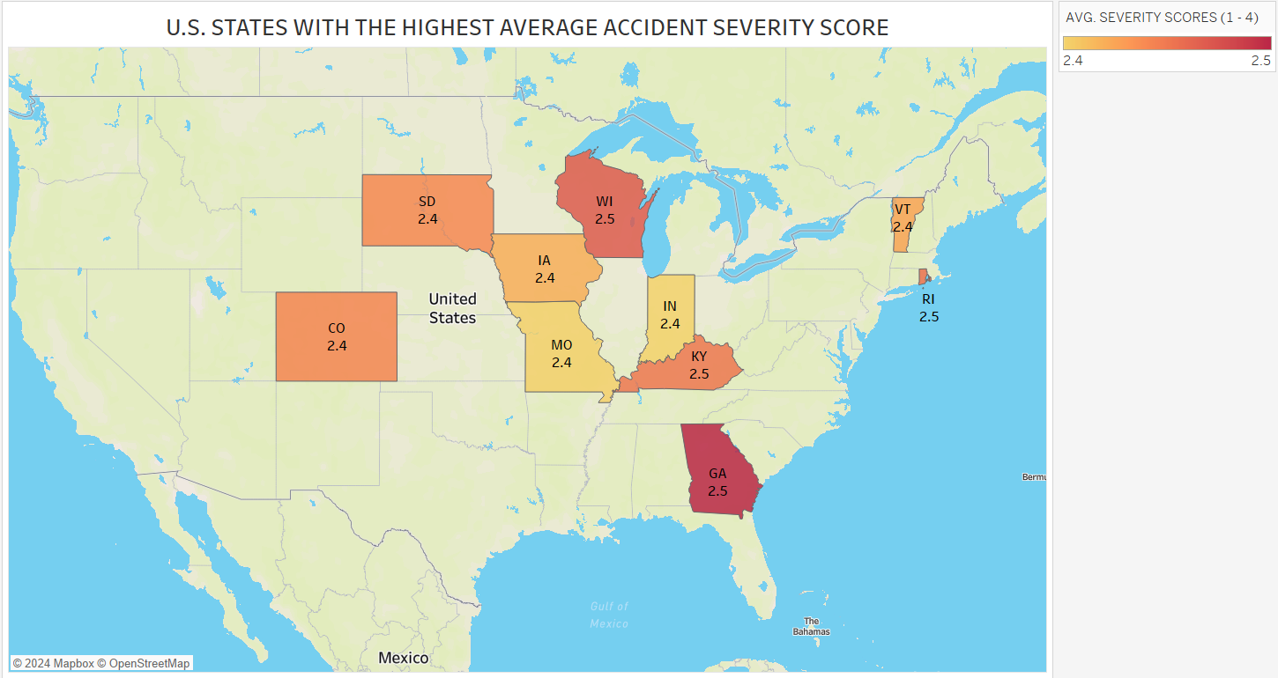
Notes:
This visualization examines the spatial distribution of road traffic accident severity across different states in the United States. The average accident severity score of each state is used to provide a color code, ranging from 1 to 4. A number nearing 4 signifies a greater magnitude of accidents in that particular state. States such as Georgia and Kentucky have the highest severity scores of 2.5, indicating more severe results from accidents compared to states like Colorado, South Dakota, and Vermont, which have scores of 2.4. This map encourages us to contemplate potential variables that may be contributing to these regional disparities. The severity rankings may be influenced by regional driving conditions, various state traffic regulations, enforcement procedures, or cultural driving patterns, which raises issues. Comprehending these trends is essential, as it can provide guidance for specific road safety measures and interventions aimed at decreasing the severity of accidents and enhancing overall traffic safety in states with higher risk.

Slide 4
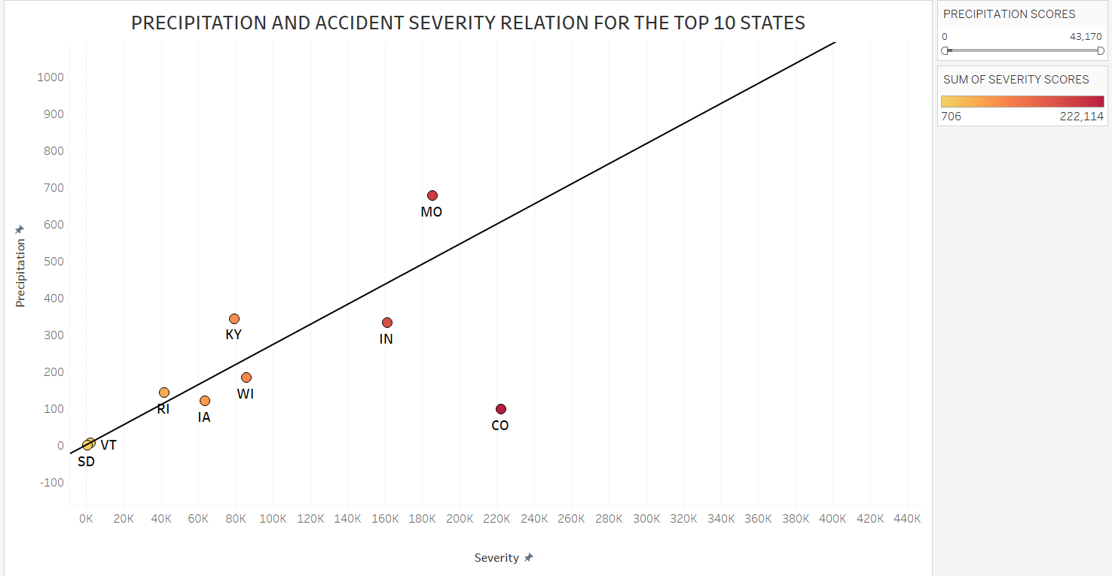
Notes:
This scatter plot examines the correlation between precipitation levels and accident severity in the top 10 states. Every point on the graph corresponds to one of these states, indicated by its associated acronym. The X-axis represents the magnitude of accidents, while the Y-axis shows the amount of precipitation in millimeters. The trend line indicates a strong positive link between the quantity of rainfall and the intensity of traffic accidents. As the amount of precipitation rises, the severity of accidents also increases, suggesting that wetter conditions may be a contributing factor to more severe accidents. This pattern requires a more thorough examination of whether these states have sufficient mechanisms in place to effectively handle road safety in challenging weather circumstances, such as rain or snow. The analysis is essential for comprehending the influence of weather-related elements on road safety and emphasizes the significance of integrating weather-adaptive methods into traffic management and infrastructure development in these states.

Slide 5
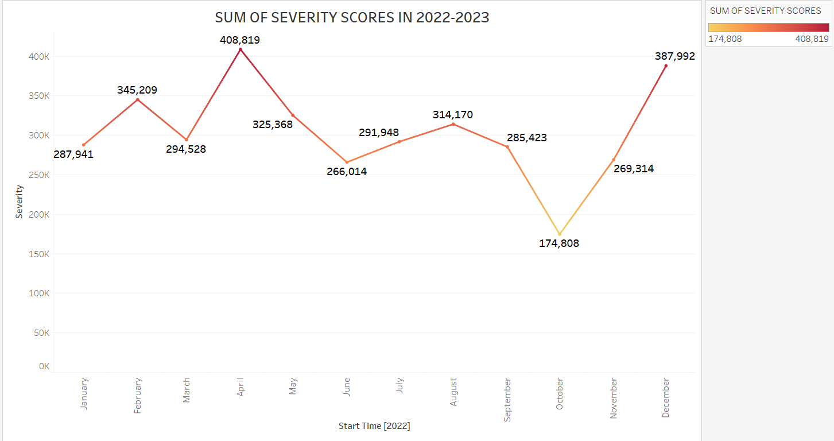
Notes:
The line graph depicts the monthly fluctuations in the cumulative accident severity scores between January 2022 and December 2023. Upon analyzing the data, a discernible pattern becomes apparent, indicating notable variations in severity scores over the course of the year. The spikes in February and November suggest months with exceptionally high accident rates, maybe attributable to seasonal variables like harsh winter weather or more traffic during holidays.
On the other hand, a significant decline in September indicates a reduction in either the quantity or intensity of accidents, which may be due to improved weather conditions or less traffic congestion. This pattern compels us to contemplate the influence of external variables such as weather conditions, holiday congestion, and conceivably alterations in driving conduct as a result of academic terms.
Gaining insight into these patterns is crucial for formulating precise safety interventions and policies designed to mitigate the frequency and intensity of traffic collisions. For example, implementing improved road maintenance prior to the winter season and intensifying traffic surveillance during significant holidays could prove to be useful tactics. Furthermore, this research assists stakeholders in road safety and urban planning to identify certain periods of the year that necessitate additional attention, facilitating the allocation of resources and endeavors to enhance road safety and mitigate the consequences of serious accidents.

Slide 6
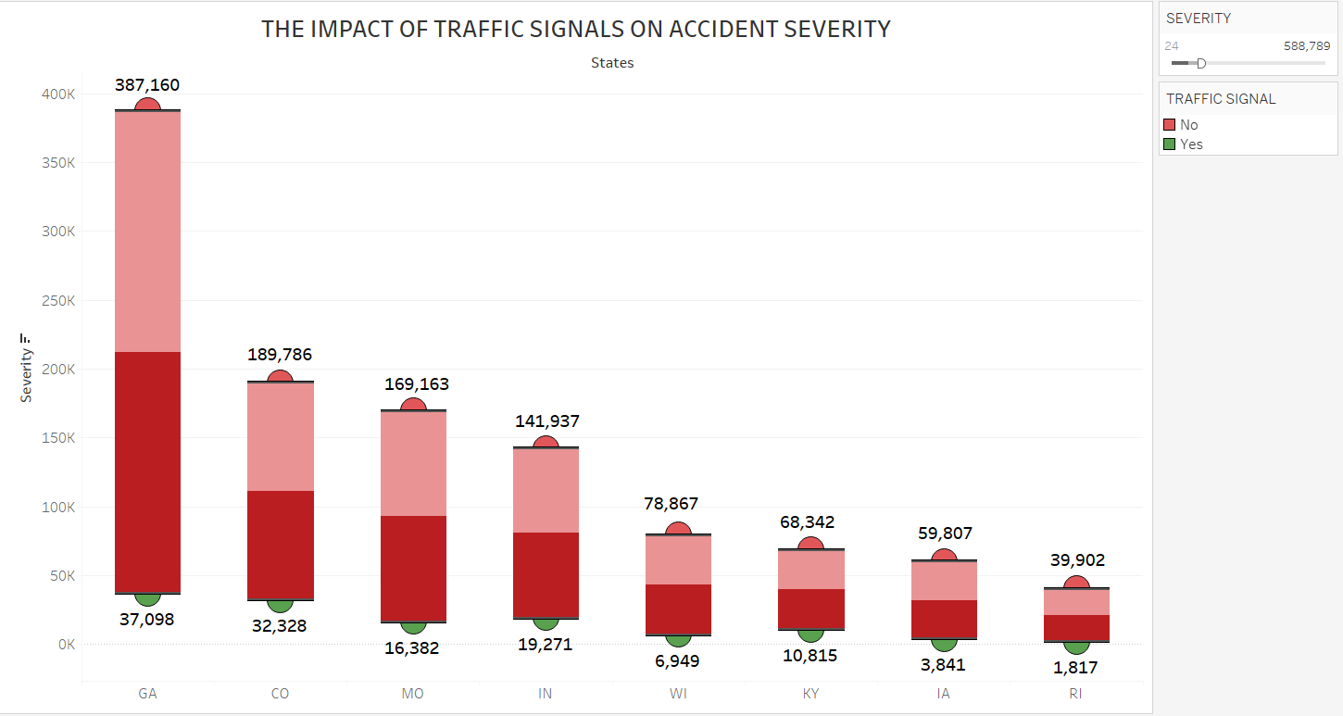
Notes:
This Whisker box chart depicts the correlation between the existence of traffic signals and the intensity of traffic collisions in different states. Each bar represents a state and displays the overall severity of accidents, which is divided into two categories: accidents that took place at places with traffic signals (shown in red) and accidents that occurred at locations without traffic signals (indicated in a darker shade). An interesting finding is the considerably greater severity of accidents in areas with traffic signals in certain states, such Georgia, where the severity score reaches 387,160, in contrast to far lower ratings in areas without signals. This pattern indicates that although traffic signals are intended to control traffic and improve safety, junctions with these signals may also be areas where serious accidents occur, maybe due to variables such as higher vehicle concentration or failure to follow traffic regulations. In contrast, in states such as Rhode Island, the existence of traffic signals is associated with a decreased accident severity score, indicating that traffic signals in that area may efficiently regulate traffic and minimize the consequences of accidents. This data highlights the intricate nature of traffic management and emphasizes the necessity for specific safety measures. It implies that having traffic signals alone is not a universal solution for road safety; their efficacy may rely on supplementary elements such as signal timing, public adherence to traffic regulations, and other existing road safety measures. The observations derived from this graph are crucial for traffic engineers and policymakers as they evaluate and enhance the road safety infrastructure in different states.

Slide 7
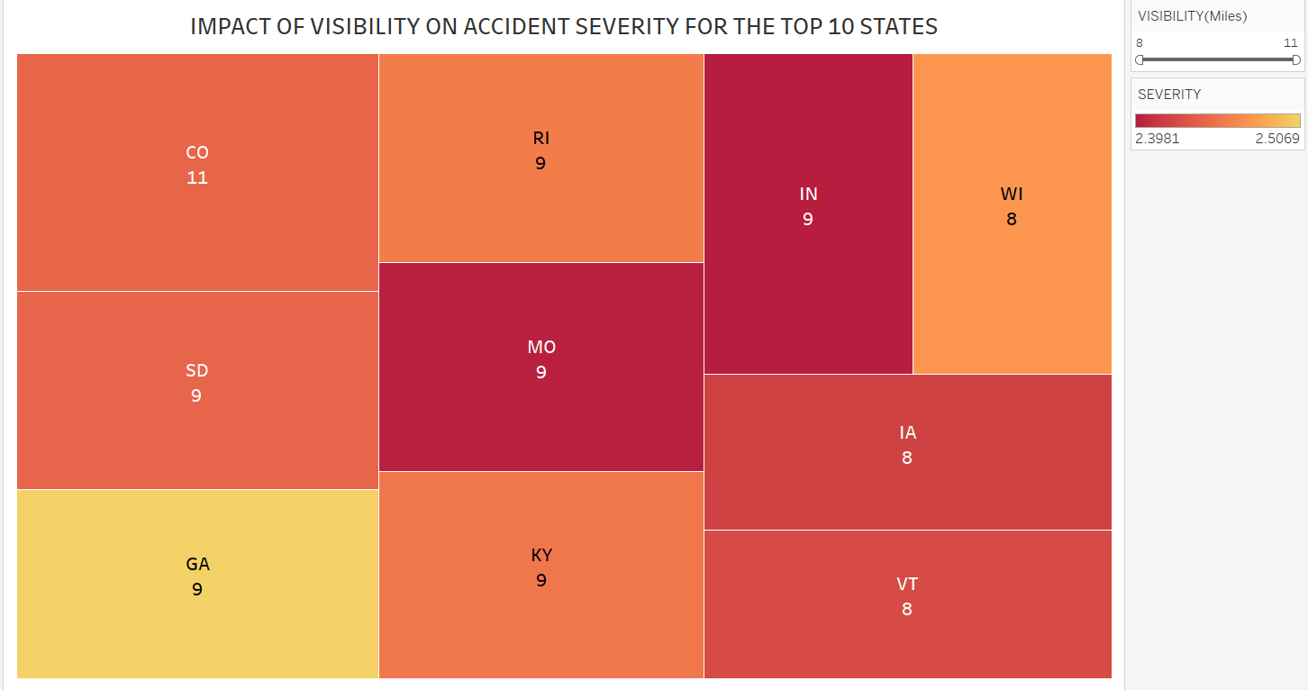
Notes:
This tree map demonstrates the relationship between visibility conditions and the severity of accidents in the top 10 states. Every block symbolizes a state and is color-coded according to the average visibility during accidents. Additionally, the size of each block corresponds to the severity score of accidents. The numerical value in each block is the mean distance at which objects may be clearly seen in miles. The picture demonstrates the varied influence of visibility on the severity of accidents. Colorado, for example, has the highest average visibility of 11 miles. However, it still has high severity scores, suggesting that strong visibility alone does not always reduce the severity of accidents. This may be attributed to variables such as excessive velocities or complex road configurations. On the other hand, states such as Wisconsin and Vermont, where visibility is limited to 8 miles, have varying severity scores. This indicates that less visibility can worsen the severity of accidents, possibly because of longer reaction times and poorer driver awareness of their surroundings. The tree map illustrates the intricate relationship between environmental visibility and accident outcomes, emphasizing that visibility is a crucial aspect that interacts with various other variables affecting road safety as a whole. The insights obtained from this visualization are crucial for policymakers and road safety authorities to devise more efficient safety strategies customized to the distinct environmental and infrastructural circumstances in each state. These findings can be used to direct the implementation of focused interventions, including as improving illumination, enhancing road signage, and conducting public awareness campaigns that explicitly target visibility difficulties. The goal of these interventions is to decrease the likelihood and seriousness of accidents.

Slide 8
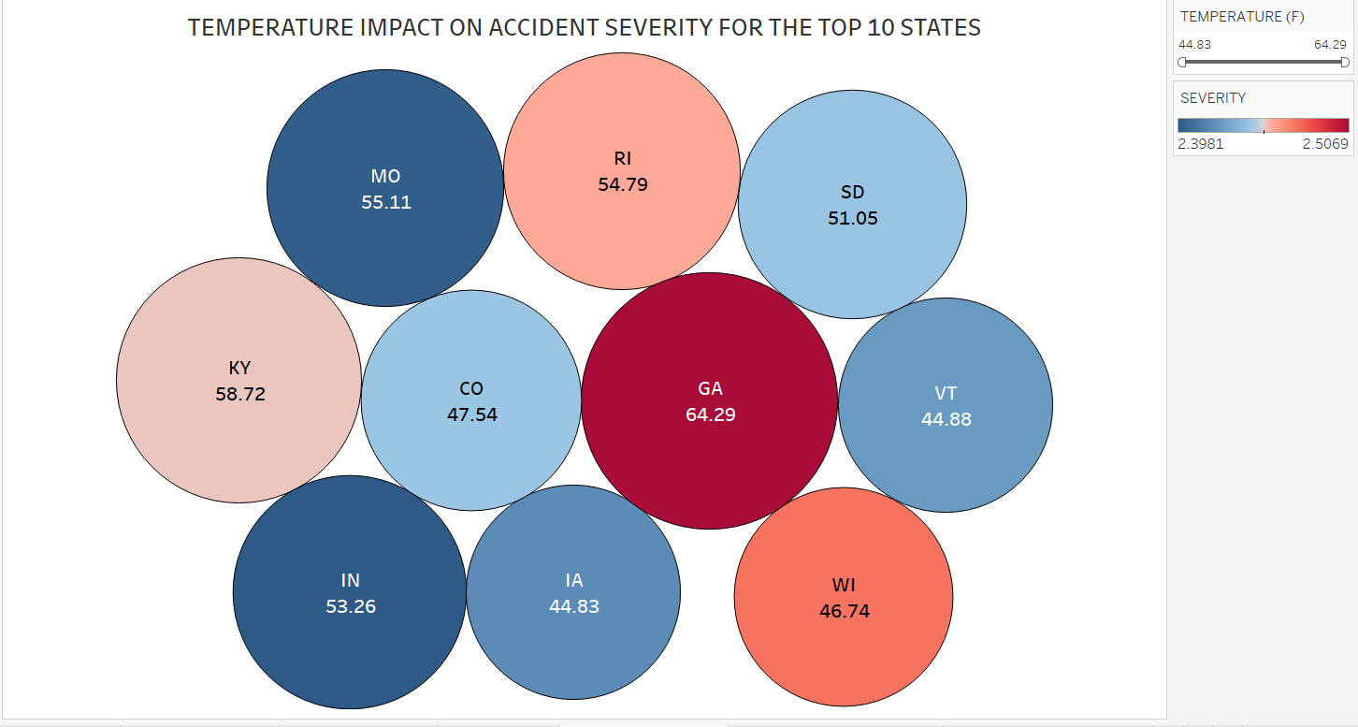
Notes:
This bubble chart depicts the correlation between average temperatures and the severity of accidents in the top 10 states. Each circle in the visualization corresponds to a specific state. The size of the circle is proportional to the severity of accidents in that condition, while the color of the circle corresponds to different temperature ranges. The temperature in degrees Fahrenheit is indicated within each circle for the purpose of clarity. The picture clearly shows that Georgia has the highest accident severity, with an average temperature of 64.29°F. This suggests that warmer circumstances do not necessarily result in safer driving settings. On the other hand, places such as Vermont and Wisconsin, which have average temperatures of approximately 44.88°F and 46.74°F respectively, also show considerable accident severities. This suggests that lower temperatures can also contribute to higher accident severities. This analysis emphasizes the intricate relationship between temperature and accident severity, which may be impacted by factors such as road conditions, driver behavior in different weather conditions, and state-specific traffic safety measures. For example, states with lower temperatures may encounter frozen roads, leading to more severe accidents, whereas states with higher temperatures may face challenges such as heat fatigue, which can impact driver focus. The information presented in this figure is vital for comprehending the correlation between environmental temperature and road safety. It implies that strategies to decrease the seriousness of accidents cannot be universally applicable but must be customized to the distinct climatic conditions of each state. This may entail employing many tactics, such as improving road maintenance during colder seasons and launching traffic safety campaigns that raise awareness about the risks of heat during warmer periods. These useful insights are essential for legislators, road safety analysts, and urban planners who want to design safer driving environments that are customized to the unique requirements and circumstances of each state.

Slide 9
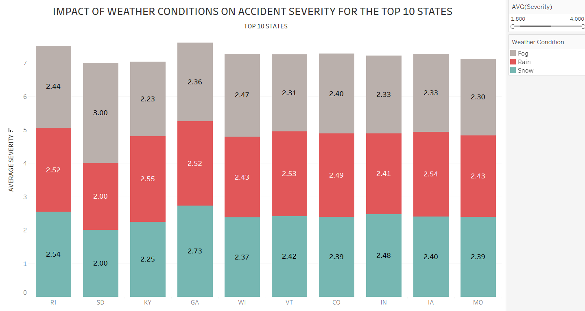
Notes:
This staked bar graph illustrates the influence of various meteorological conditions, namely fog, rain, and snow, on the severity of accidents in the top 10 states. Each state is depicted by a bar that is divided into three colors, representing the average severity of accidents under different weather conditions. The scale at the top displays the mean severity score, which spans from 1.8 to 4.0. By examining the chart, we may discern clear and identifiable patterns. For instance, in Kentucky (KY), incidents that take place in foggy conditions have the highest severity, with a score of 3.00, signifying that fog has a substantial impact on driving safety in this state. On the other hand, Georgia (GA) has a greater level of seriousness in rainy weather, as indicated by a score of 2.73. This implies that rain could potentially present a more significant danger in this area. The disparity among states demonstrates that the severity of accidents is influenced by weather conditions in a state-specific manner. There are several possible reasons for this, including the usual weather patterns in the state, the level of driver preparedness for various weather situations, and the quality of road upkeep and infrastructure. Gaining a comprehensive understanding of these subtle distinctions is essential for creating precise safety protocols and actions. States experiencing increased severity ratings due to fog could potentially benefit from implementing fog-warning systems and upgrading road illumination. On the other hand, states with greater severity scores in rain could prioritize enhancing drainage systems and encouraging the adoption of weather-appropriate tires. This graphic aids policymakers, road safety analysts, and urban planners in identifying the most perilous weather conditions in certain places and customizing their road safety measures accordingly. By tackling these particular obstacles, we can strive to diminish the severity of accidents and improve general traffic safety in unfavorable weather circumstances.

Slide 10
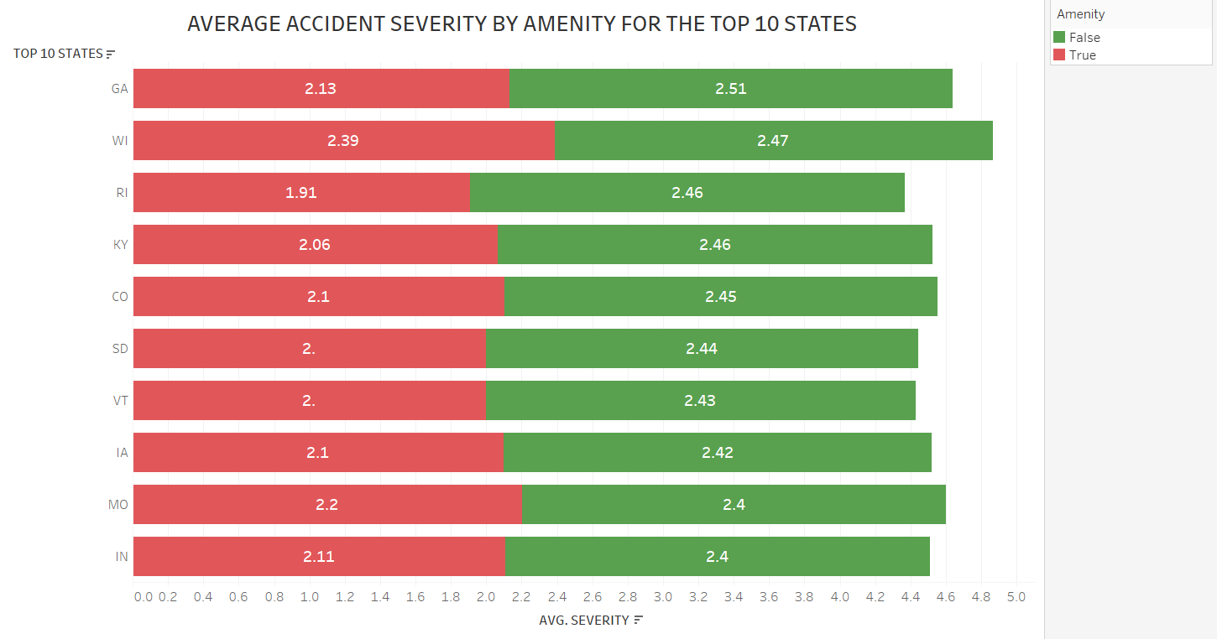
Notes:
This bar chart illustrates the average accident severity in the top 10 states, comparing locations with amenities (such as traffic lights, stop signs, crosswalks) against those without. Each state is represented by a pair of bars: the red bar indicates average severity scores where no amenities are present, and the green bar shows scores where amenities are present.
From this visualization, we can observe a clear pattern: in almost all the states, accident severity is significantly higher in locations lacking amenities. For example, in Georgia, the severity score without amenities is 2.13, compared to 2.51 where amenities are present, reflecting a noticeable decrease in severity due to the influence of safety-enhancing features.
This trend suggests that amenities play a crucial role in reducing the severity of accidents. Amenities likely contribute to better traffic management and safer pedestrian movement, thereby reducing the likelihood of severe accidents. States like Wisconsin and Rhode Island show some of the highest differentials, indicating that investments in road safety infrastructure can have a substantial impact on reducing the consequences of accidents.
The implications of this data are significant for urban planners and policymakers. It underscores the importance of ensuring that adequate road safety amenities are installed in all areas, especially those currently lacking. By addressing these disparities, we can make significant strides towards enhancing overall traffic safety and reducing accident severity across the board.
This chart serves as a compelling argument for increased funding and focus on road safety infrastructure as a direct and effective measure to mitigate the severity of road accidents.

